Slide 1

PROS Hackathon 2018
Katie Jewett, Brianna Frausto, Matthew Mutammara, Arman Khondker
eCommerce Pricing with Competitive Intelligence
July 9, 2018

Slide 2
Agenda:
Introduction
Prompt
Vision
Making the UI
Building Pricing Model
Sentiment Analysis
Demo
Q & A

Slide 3
Get to Know Us!
Brianna Frausto IT intern
Katie Jewett
Arman Khondker
Matthew Mutammara
Product Development
Interns

Slide 4
What Are We Doing?
“Develop a B2B pricing solution that can leverage competitor prices based upon pricing data repositories, screen-scraping tools, indexes, or other data sources in dynamic and sustainable manner.”

Slide 5
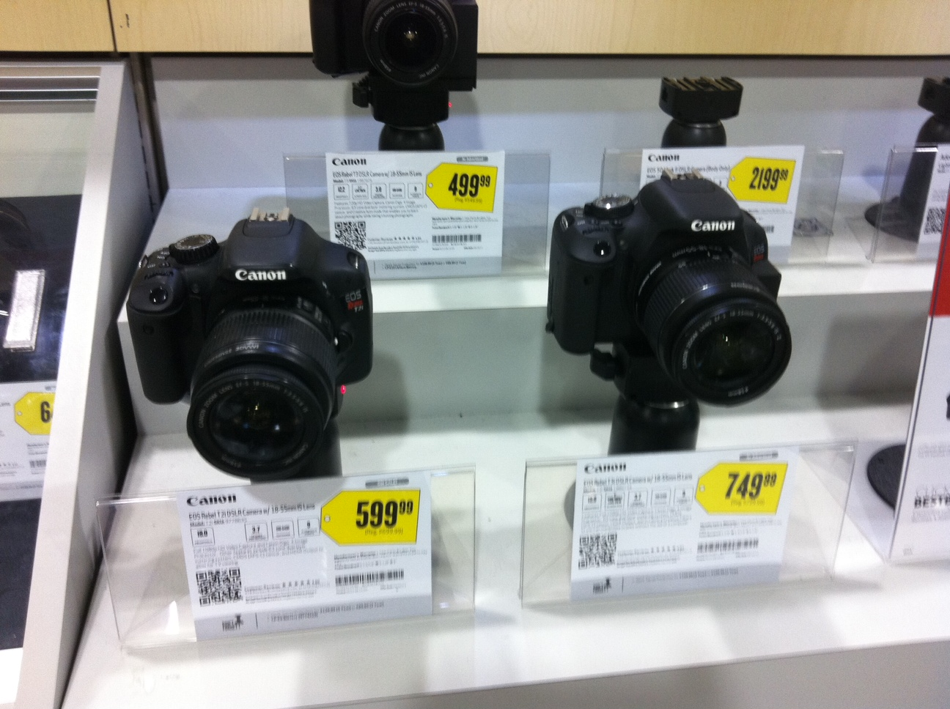
Vision
Focused on electronics – camera data
Insight into market value of similar products
Price estimator + sentiment analysis (@millennials!!!)

Slide 6
User-Friendly, High-Detail User Interface

Slide 7
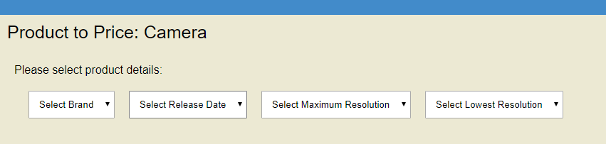
UI: How It Looks
User friendly and high in detail
Clean, lots of inputs

Slide 8
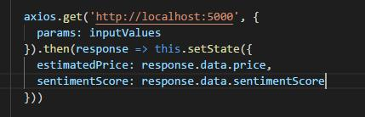
UI: How It Works
Tools: React, JavaScript, Axios
Send inputs, receive price and sentiment score

Slide 9
Modern A.I. Applied to Price Estimation

Slide 10
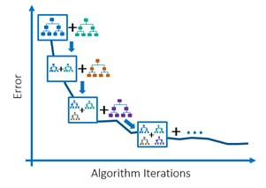
Estimator
Use camera features to estimate market valuation
Resolution, zoom, pixels, storage, etc.
Separate training/testing data
Python: scikit-learn, pandas
One-hot encoding
K-Means Clustering
Gradient Boosting Regression
Flask REST API to connect to frontend

Slide 11
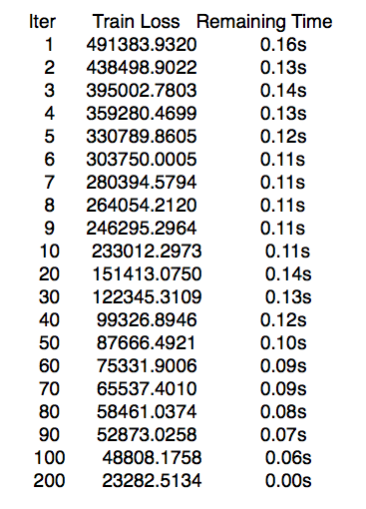
Choosing a Model
Linear Regression
MSE: 341524.5100
K-Nearest Neighbors
MSE: 364646.2164
Naive Bayes
MSE: 897169.2476
Multi-Layer Perceptron
MSE: 228671.6356
Gradient Boosting Regression
MSE: 98734.653

Slide 12
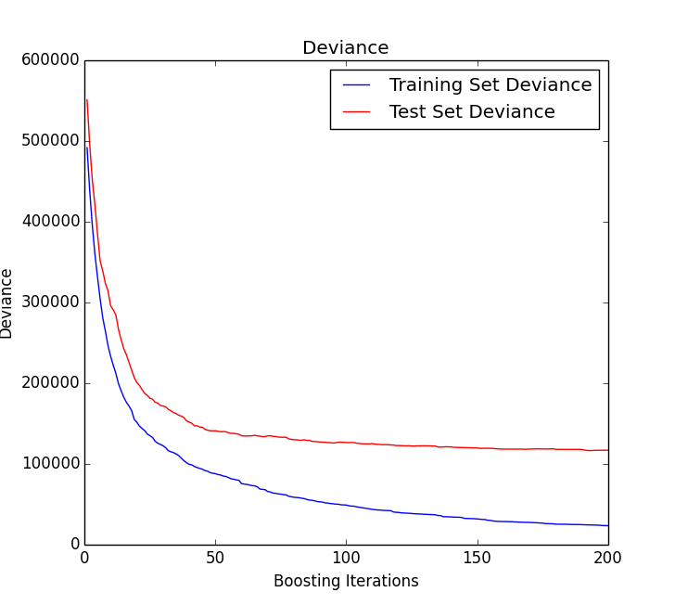
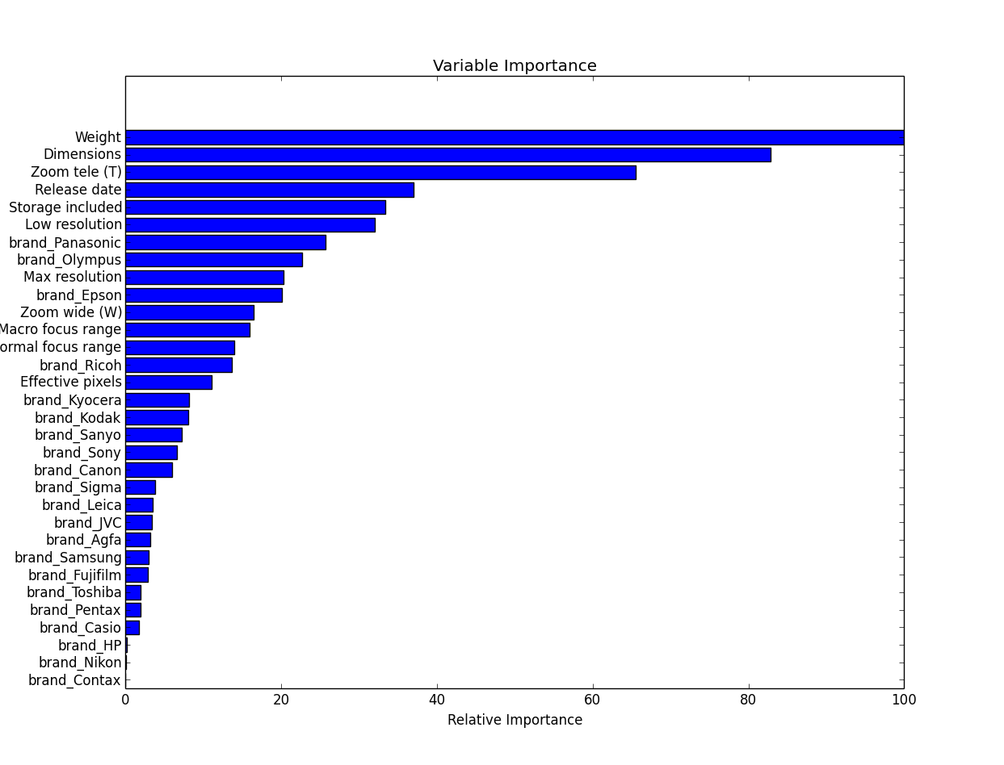
Model Results

Slide 13
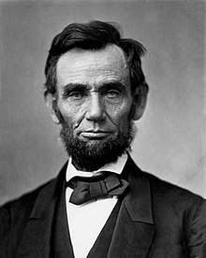
Public sentiment is everything. With it, nothing can fail; against it, nothing can succeed.
- Abraham Lincoln

Slide 14
Innovative Solution for Gauging User Sentiment

Slide 15



Using To Leverage Public Sentiment
Google Cloud Platform
YouTube Data API v3
Python Script
NLTK (Natural Language Toolkit)
Vader Lexicon
Bot to Parse Comments
Real Time User Sentiment
Dynamic Feedback on Product

Slide 16

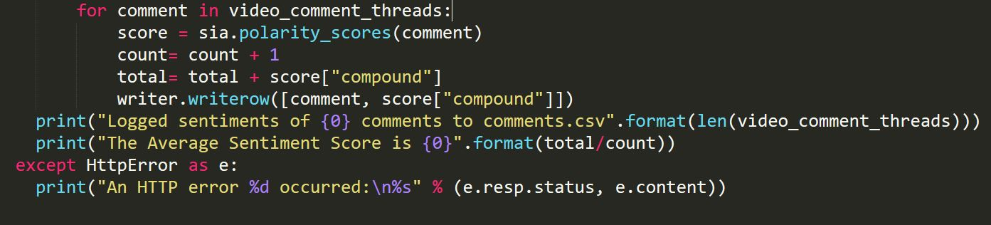
Using the Data API v3
Allows access to comments on particular video IDs
Utilize NLTK library and Vader Lexicon for polarity scores
Log each comment and score to csv

Slide 17
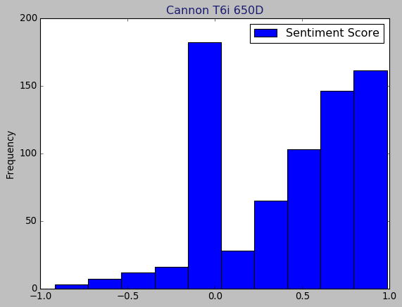
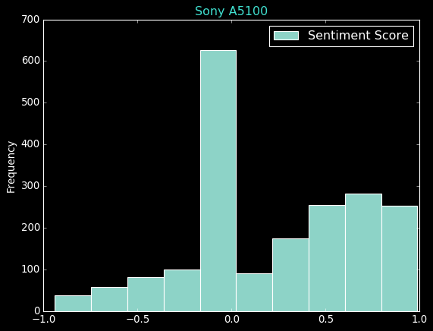
Sentiment Analysis

Slide 18
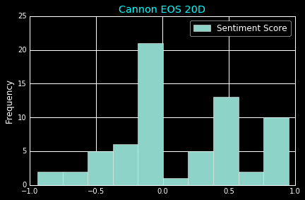
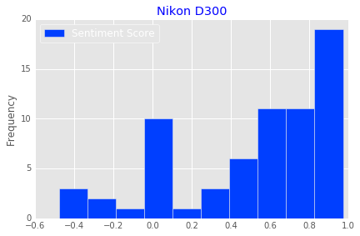
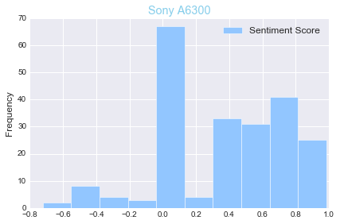
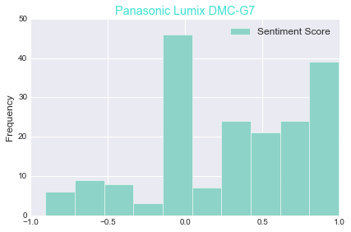
Sentiment Analysis

Slide 19
DEMO Time!

Slide 20

Moving Forward
Improvements:
Larger, more recent data source
Screen scraping
Amazon reviews
Blog reviews
Internationalization
Improve machine learning model

Slide 21
Wrapping Up
Machine Learning
Public Sentiment of Brand
Dynamic and Flexible Product
Applicable to Many Fields (not just cameras!)

Slide 22
Q&A

Slide 23
Thank you

